Slide 1

Finance and Risk Analytics – Capstone Project
By
Sreedhar Sasthangal

Slide 2
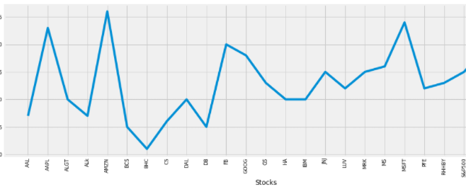
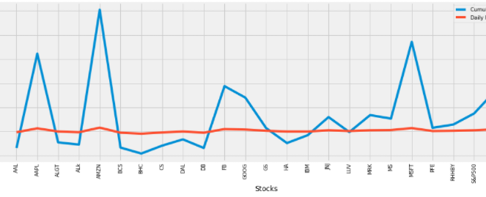
Mr. Patrick Jyengar Portfolio
We can see that Apple, Amazon, Facebook, Google, Microsoft, United health have given better daily returns.
AMZN gives 40.59% annual returns
MSFT gives 34.95% annual returns
AAPL gives 33.32% annual returns
FB gives 26.45% annual returns
UNH gives 23.72% annual returns
GOOG gives 21.02% annual returns

Slide 3
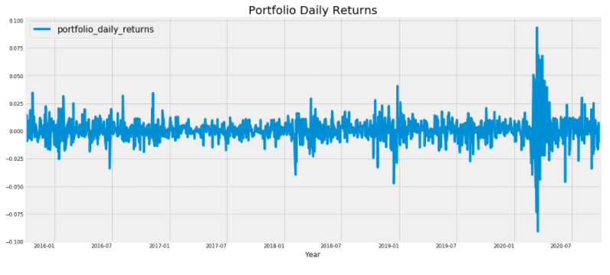
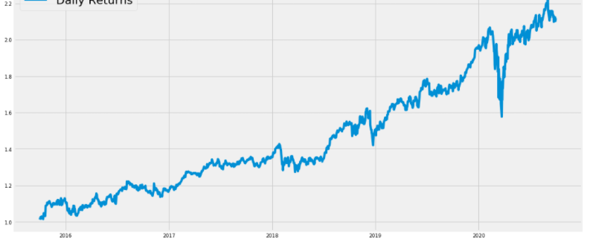
As seen in the plot, the portfolio shows larger variation in prices from 2018 to 2019.
The portfolio has achieved a cumulative return of 1.11% in the given period

Slide 4
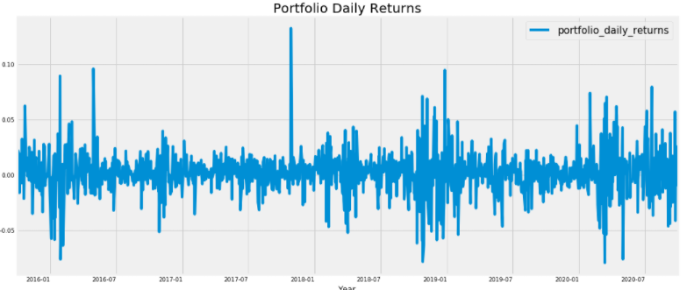
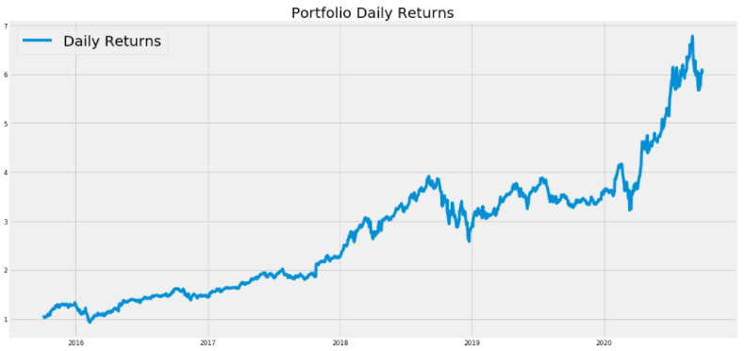
Mr. Peter Jyengar Portfolio
The portfolio shows larger variation in prices from end of 2017 to 2020.
The portfolio has achieved a cumulative return of 5.04% in the given period.
Mr.Peter jyengar invests 1 Million Dollar on equities i.e the above Portfolio. Returns that he would fetch after 5 years is more than 6 Million Dollars with 5+ Million dollars of gain

Slide 5
Conclusion
In this Notebook we have explored stock prices of tech stocks, pharma stocks, Aviation stocks, finance stocks & market Index also. We have looked at the historical price of stock price. We have looked at the volume of stock traded.
We have looked at the daily Return of stock. We have done correlation between the stock prices. Microsoft and Amazon have highest daily price correlation. Maximum daily fluctuation in the stock is 8 % .In stock exchange there is a limit on per day fluctuation of stock. So, if the stock reaches the threshold value, then the trading of the stock is stopped for that day.
Stock with Low risk and high return are the best stock to buy. We can see that Amazon Stock has high risk and high returns.

